Slide 1
Nuclear
Atoms and the Periodic Table
Radiation
Alpha
Beta
Gamma
Radiation continued
Activity and half-life
Doses and effects of radiation
Binding energy
Nuclear power

Slide 2

SCSA ATAR Syllabus (up to date as of 14/11/17; https://senior-secondary.scsa.wa.edu.au/syllabus-and-support-materials/science/physics)
Science Understanding
the nuclear model of the atom describes the atom as consisting of an extremely small nucleus which contains most of the atom’s mass, and is made up of positively charged protons and uncharged neutrons surrounded by negatively charged electrons
nuclear stability is the result of the strong nuclear force which operates between nucleons over a very short distance and opposes the electrostatic repulsion between protons in the nucleus
some nuclides are unstable and spontaneously decay, emitting alpha, beta (+/-) and/or gamma radiation over time until they become stable nuclides
each species of radionuclide has a half-life which indicates the rate of decay This includes applying the relationship $N=N_{0}{(\frac{1}{2})}^{n}$
alpha, beta and gamma radiation have different natures, properties and effects
the measurement of absorbed dose and dose equivalence enables the analysis of health and environmental risks This includes applying the relationships $absorbed dose=\frac{E}{m}$, $dose equivalent=absorbed dose×quality factor$
Einstein’s mass/energy relationship relates the binding energy of a nucleus to its mass defect This includes applying the relationship $∆E=∆mc^{2}$
Einstein’s mass/energy relationship also applies to all energy changes and enables the energy released in nuclear reactions to be determined from the mass change in the reaction This includes applying the relationship $∆E=∆mc^{2}$
alpha and beta decay are examples of spontaneous transmutation reactions, while artificial transmutation is a managed process that changes one nuclide into another
neutron-induced nuclear fission is a reaction in which a heavy nuclide captures a neutron and then splits into smaller radioactive nuclides with the release of energy
a fission chain reaction is a self-sustaining process that may be controlled to produce thermal energy, or uncontrolled to release energy explosively if its critical mass is exceeded • nuclear fusion is a reaction in which light nuclides combine to form a heavier nuclide, with the release of energy
more energy is released per nucleon in nuclear fusion than in nuclear fission because a greater percentage of the mass is transformed into energy
Science as a Human Endeavour
Qualitative and quantitative analyses of relative risk (including half-life, absorbed dose, dose equivalence) are used to inform community debates about the use of radioactive materials and nuclear reactions for a range of applications and purposes, including:
radioisotopes are used as diagnostic tools and for tumour treatment in medicine
nuclear power stations employ a variety of safety mechanisms to prevent nuclear accidents, including shielding, moderators, cooling systems and radiation monitors
the management of nuclear waste is based on the knowledge of the behaviour of radiation.

Slide 3
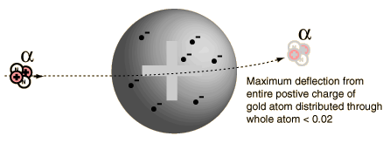
History of the Atom
Matter is made up of atoms.
1890 J.J. Thompson put forward the idea of a plum pudding theory.

Slide 4
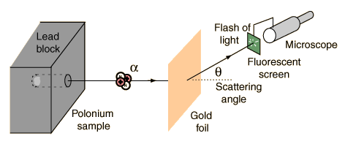
1911 Rutherford’s gold foil experiment
Alpha particles were shot at a thin layer of gold.
Results:
Most went straight through
Others rebounded
Others deflected

Slide 5
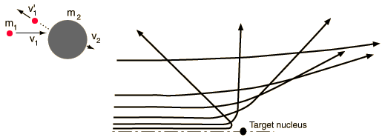
Rutherford’s conclusions
Atom has a nucleus of positive charge.
An atom is made up mostly of space.
Electrons orbit around the nucleus.
The nuclear atom model was born.
Niels Bohr worked further on this model.

Slide 6
Neutron
Discovered in 1930 by James Chadwick
Late discovery because they are uncharged
Hard to detect or manipulate

Slide 7
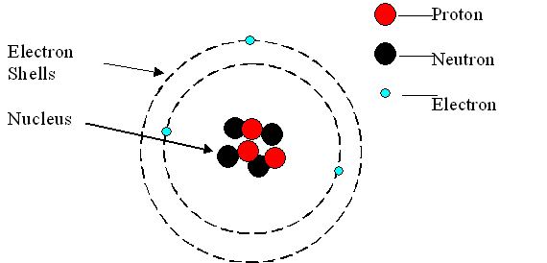
Structure of the Atom
The atom’s nucleus is made up of nucleons:
Protons (p) that are positively charged and carry a mass of 1 atomic mass unit (amu)
Neutrons (n) that are neutral and carry also a mass of 1 amu.

Slide 8
Forces in the nucleus
Protons repel each other because they are all positively charged (electrostatic repulsion)
The nucleus is held together by the strong nuclear force, a force of attraction acting between all nucleons (protons and neutrons)
Nuclear force is a very strong short range force (particles are 10⁻¹⁵ m apart). Electrical and gravitational force are long range forces.

Slide 9
Electrons
The negatively charged electrons orbit the nucleus in energy levels. Their mass is so small it is considered negligible (0.00054858 amu).
The electrons are distributed in energy levels :
2 in the first
8 in the second
18 in the third
They move randomly in their allocated space.

Slide 10
Terms and data
Nucleon = particles in the nucleus ie a proton or neutron
Nuclide = nucleus
Charge on a proton = - charge on an electron = 1.60 x 10 ⁻¹⁹ C

Slide 11
Periodic Table
Atomic No (Z) = no of protons = type of element.
Atomic Mass No. (A) = no of protons + neutrons
No of neutrons = A – Z
^{A}_{Z}X -symbol for element eg ¹³₆C
C = 6 p, 6 e and 7 n

Slide 12
Example
Element | Atomic no. | Mass no. | No. protons | No. neutrons | No. electrons
Li-7 | 3 | 7
 | 13 |  |  | 14
 |  | 89 | 38
 |  |  |  | 140 | 92
He²⁺ |  |  |  | 2
Element | Atomic no. | Mass no. | No. protons | No. neutrons | No. electrons
Li-7 | 3 | 7 | 3 | 4 | 3
Al-27 | 13 | 27 | 13 | 14 | 13
Sr-89 | 38 | 89 | 38 | 51 | 38
U-232 | 92 | 232 | 92 | 140 | 92
He²⁺ | 2 | 4 | 2 | 2 | 0

Slide 13
Nuclear masses
Unified atomic mass units (u)
Based on relative scale where C-12 atom is given the value of 12.000000 u
All other atoms mass is relative to C-12.
Relative atomic mass
n=1.008665u p = 1.007276 u
1u = 1.6605 x 10⁻²⁷ kg H-1 = 1.007825u

Slide 14
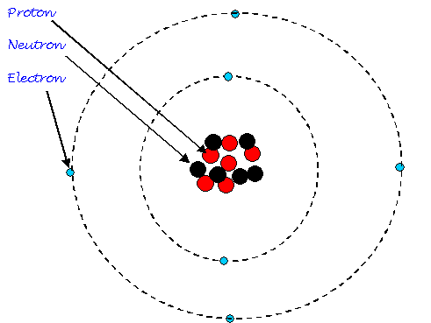
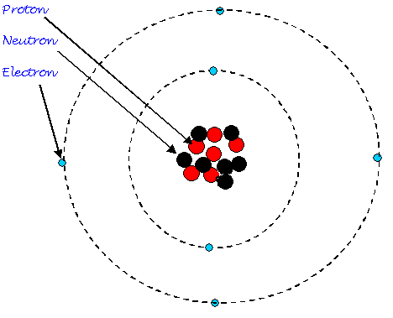
ISOTOPES
What is different between these two atoms?
What is similar?

Slide 15
Isotopes
Are atoms of the same element that have a different number of neutrons in their nucleus.
No. of p and e are the same
Atomic No the same
No of neutrons different
Mass No different.
Eg C-12, C-13, C-14, C-15, C-16

Slide 16
Isotopes
Are chemically identical.
React the same.
Bond the same.
Special case; H-1, H-2 deuterium, H-3 tritium
Radioisotopes – decay releasing radiation.
Stable isotopes – don’t decay.
Natural and artificial radioisotopes.

Slide 17
Radioactivity – Decay of Atoms
Radioactivity was discovered by Henri Becquerel.
Mineral containing U darkened an X-ray plate
Marie Curie and Pierre Curie isolate the radioactive substances Polonium and Radium
Decay of unstable atoms occur when a nucleus falls apart and emits a particle and or high energy rays.

Slide 18
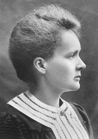
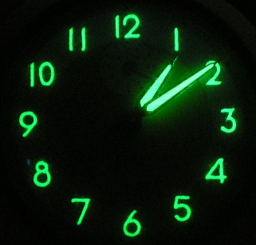
Radiation
Marie Curie discovered that thorium, (Z=90) was a radioactive element
1898: Marie and Pierre Curie discovered polonium (Z=84) and radium (Z = 88), two new radioactive elements
1867-1934
Radium paint

Slide 19
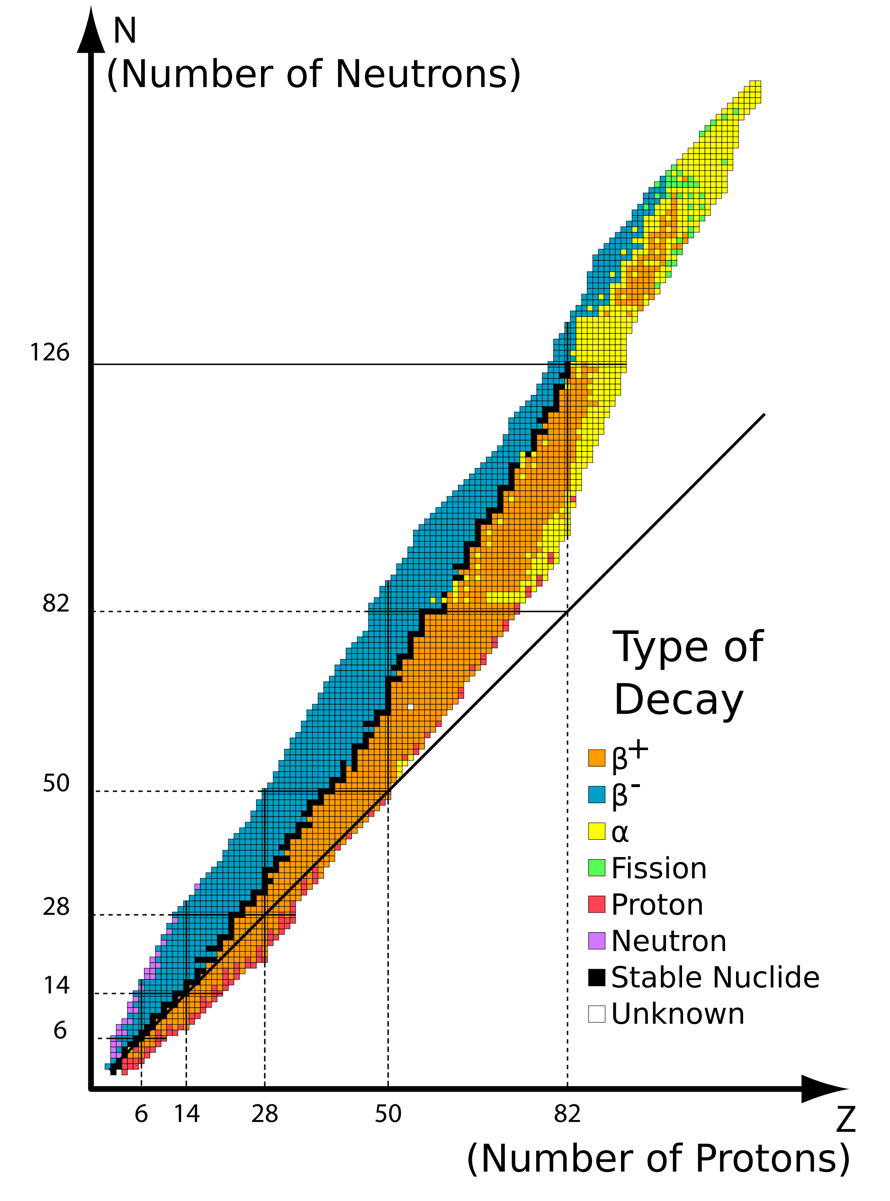
Nuclear stability - Radioactive isotopes
Radioactive isotopes have:
Too many neutrons compared to protons
Too many protons compared to neutrons
Or, they are just too big
A given nucleus is radioactive if it’s outside the band of stability
By emitting radiation they become closer to a stable nucleus

Slide 20
Nuclear stability explained
Strong nuclear force holds protons and neutrons together.
This force works over very short distances.
It overcomes the repulsive forces of protons
Larger atoms the nuclear force is less effective as distances increase so ratio of neutrons:protons must increase.
Z <20 n = p
20<Z<82 n:p>1
Z>82 unstable

Slide 21
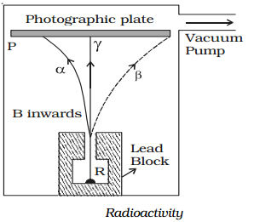
Types of radiation
1901 Ernest Rutherford found three types of radiation were emitted from a radium source, by separating the beam with a magnetic field
α +ve
β -ve
γ neutral

Slide 22
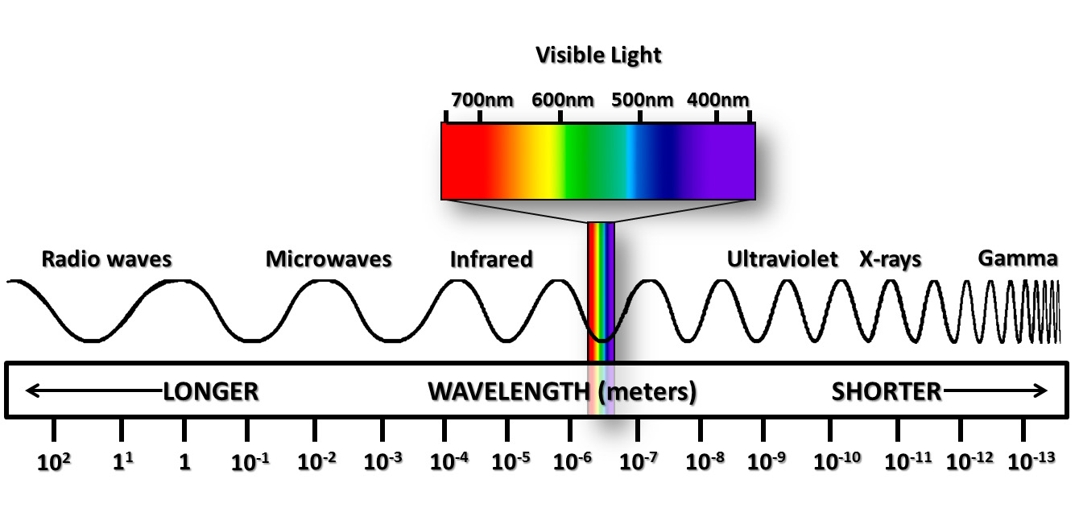
Electromagnetic Radiation
Spectrum
Caused by excitation of electrons within atoms or the acceleration of charged particles.
Visible light, Radio waves, Microwaves, X-rays
Gamma rays – caused by changes to nucleus.

Slide 23
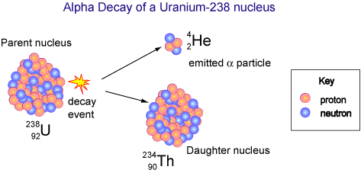
Alpha Decay
When a nucleus decays by alpha decay, it ejects a helium nucleus (not atom). The nucleus recoils, just like a canon firing a canon ball. Energy is released as well.
Alpha Particle: ⁴₂He²⁺

Slide 24
Alpha Radiation (α)
α is a helium nuclide.
Two positive charge
Travels at 1/10 the speed of light
Large slow moving particle.
Very ionising
Stopped easily by a few cm air, or paper.

Slide 25
Alpha Decay Reactions
²³⁴₉₀Th + ⁴₂α
²³⁸₉₂U →
²²⁶₈₈ Ra →
²¹⁰₈₄ Po →
Nuclear equations: conservation of charge and mass.
Reason: parent nucleus is unstable, nuclear force unable to hold nucleons together.
²²²₈₆Rn + ⁴₂α
²⁰⁶₈₂Pb + ⁴₂α

Slide 26
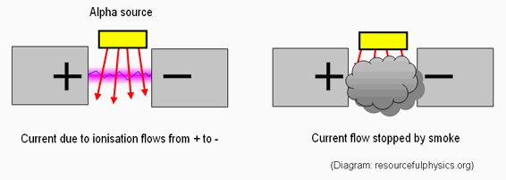
Alpha Decay Use – Smoke Detector
The alpha particles emitted by the Am-241 collide with the oxygen and nitrogen in air in the detector's ionisation chamber to produce charged particles called ions.
A low-level electric voltage applied across the chamber is used to collect these ions, causing a steady small electric current to flow between two electrodes.
When smoke enters the space between the electrodes, the alpha radiation is absorbed by smoke particles. This causes the rate of ionisation of the air and therefore the electric current to fall, which sets off an alarm.

Slide 27
Beta minus decay (β⁻)
Beta particle is a nuclear electron.
A neutron decays into a proton and a beta particle.
¹₀n → ¹₁p + ⁰₋₁e + ν_{e}
¹₀n → ¹₁p + ⁰₋₁β + ν_{e}
Antineutrino particle also released. (Neutral, extremely small mass particle)
_
_

Slide 28
Beta plus (positron) decay (β⁺)
Alternatively a positron can be emitted.
A proton decays into a neutron and a beta particle (and a neutrino).
¹₁p → ¹₀n + ⁰₁e + ν_{e}
¹₁p → ¹₀n + ⁰₁β + ν_{e}
Positron is an antielectron, if a positron encounters an electron they are mutually destroyed releasing gamma rays
Assume all references to beta decay/radiation are beta minus unless otherwise specified.

Slide 29
Beta radiation (β)
Travels at 9/10 speed of light.
Single negative charge.
Less ionizing ability than alpha.
Penetrates a few m of air, thin sheet of foil.
Reason: nucleus is unstable as it has too many neutrons to protons (or too many protons to neutrons for Beta plus decay)

Slide 30
Beta decay reactions
¹⁴₇N + ⁰₋₁β + ν
¹⁴₆C →
¹⁸⁷₇₅ Re →
¹⁸⁷₇₆ Os →
Nuclear equations: conservation of charge and mass.
¹⁸⁷₇₆Os + ⁰₋₁β + ν
¹⁸⁷₇₇Ir + ⁰₋₁β + ν

Slide 31
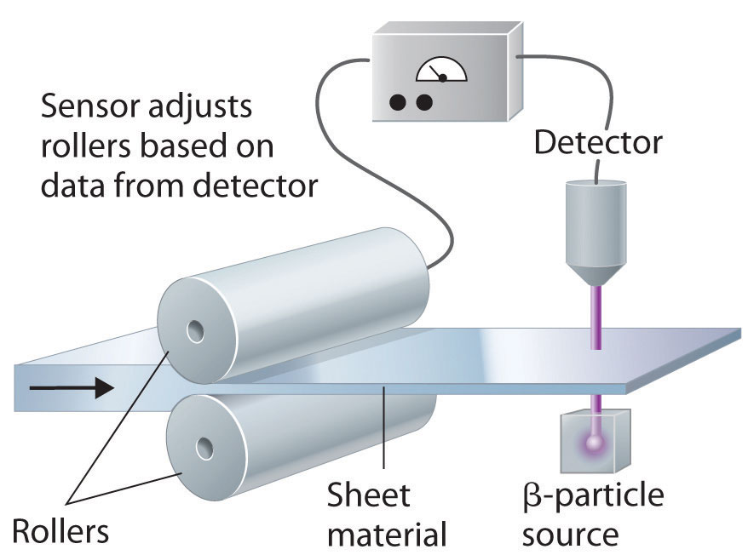
Beta decay use – Foil thickness
Beta radiation is able to penetrate thin foil but is blocked by thick foil
Used to control thickness during production

Slide 32
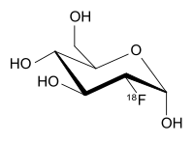
Beta plus decay uses – Positron Emission Tomography
Patient injected with a solution containing Fluorodeoxyglucose (¹⁸F)
Fluorodeoxyglucose mimics glucose so taken into body parts with high metabolic activity i.e. malignant tumours
Minimise patient physical activity to stop intake by muscles
¹⁸F decays, emitting positrons which mutually destruct with electrons, releasing gamma rays which can be seen by a camera

Slide 33
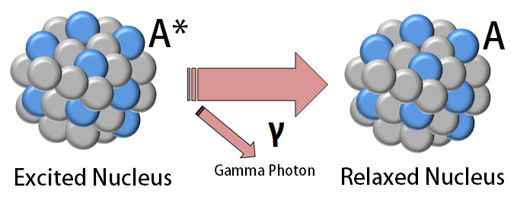
Gamma decay
Atom in excited unstable state after emission of alpha or beta (or neutron capture).
Nuclide rearranges itself and releases energy.
No transmutation on its own, number of protons/neutrons unchanged

Slide 34
Gamma radiation (γ)
No mass
No charge
Travels at speed of light.
Very penetrating, stopped by 10cm lead
Not as ionising as other beta/alpha.

Slide 35
Gamma decay reactions
²³⁴₉₁Pa + ⁰₀γ
²³⁴₉₁Pa* →
^{99m}₄₃ Tc →
Asterisk and ‘m’, both denote excited or metastable nucleus
Nuclear equations: conservation of charge and mass.
⁹⁹₄₃ Tc + ⁰₀γ

Slide 36
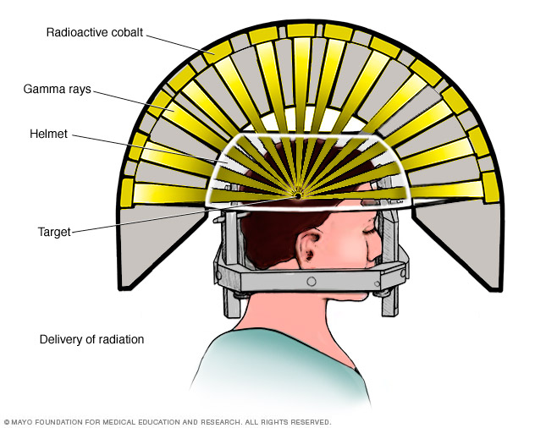
Gamma ray use – Gamma knife
Many sources of gamma rays placed around head, all aimed at cancer in the brain
Each individual beam of gamma rays is too weak to cause significant damage
The individual beams intersect at the cancer so it receives a much higher dose of radiation

Slide 37
Neutron radiation
Neutrons have no electrical charge.
They have nearly the same mass as a proton (a hydrogen atom nucleus).
The source of neutrons is primarily nuclear reactions, such as fission, but they may also be produced from the decay of radioactive nuclides.
Because of its lack of charge, the neutron is difficult to stop and has a high penetrating power.
Neutrons can be absorbed by nuclides.

Slide 38
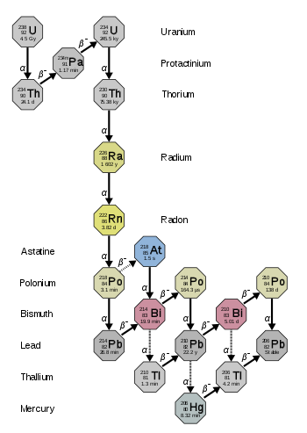
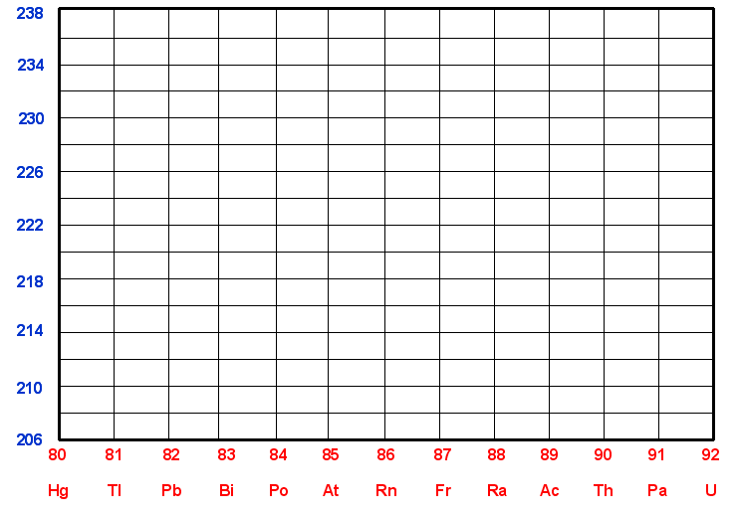
Decay series
Radioactive atoms can undergo a series of decays ie daughter nuclide decays, grand daughter nuclide decays further.
ALPHA
BETA

Slide 39
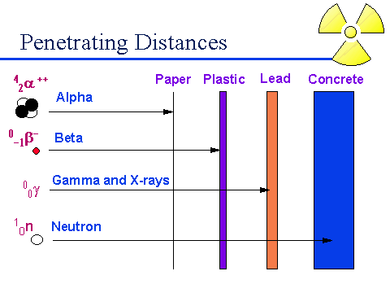
Penetrating power

Slide 40
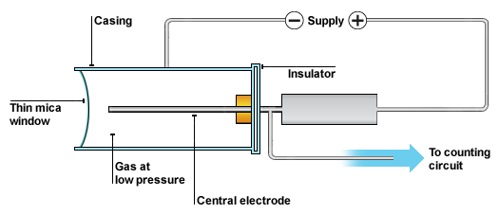
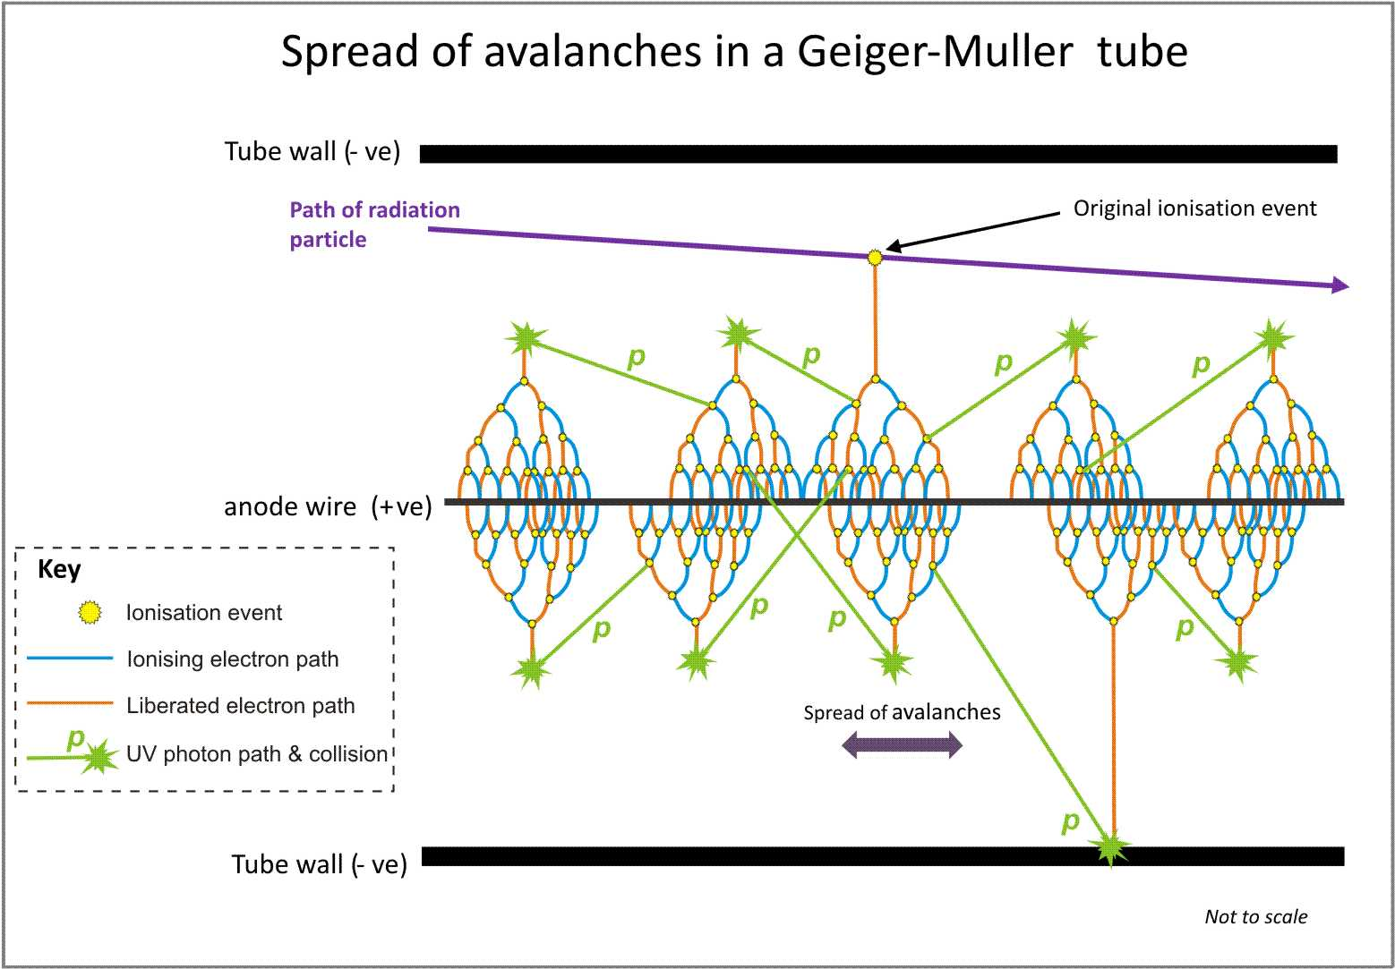
Detecting radiation – Geiger-Müller tube
An inert gas-filled tube (Ar) that briefly conducts electricity when a particle or photon of ionising radiation makes the gas conductive by ionising the gas.
The tube amplifies this conduction by a cascade effect and outputs a current pulse, which is displayed by a needle, lamp and/or audible clicks.
Geiger detectors are still favoured as general purpose alpha/beta/gamma portable contamination and dose rate instruments, due to their low cost and robustness.

Slide 41
Radioactive decay (transmutation) of atoms
Is a random process
It is impossible to say when a particular nucleus will decay
It is only possible to predict what fraction of the radioactive nuclei will decay in a certain time
Half-life of a radioactive isotope is the average time it takes for half of its atoms to decay.

Slide 42
Half-life t_{1/2}
Number of atoms, N
The rate of decay depends on the amount of material present, so the decay is exponential
Initial numb of atoms, N₀
t_{1/2}
t_{1/2}
t_{1/2}
time, t

Slide 43

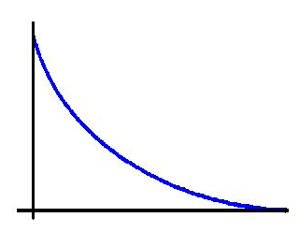
half-life continued
N = number of remaing undecayed atoms
N₀ = original number of atoms
n = no of half lives elapsed
When N=0.5N₀ then t = t_{1/2}
N
N₀
$$N=\frac{N_{0}}{2^{n}}$$
t

Slide 44

Activity
Number of decay events per second
Measured in Becquerels (Bq)
1 Bq = 1 decay per second
$$A=\frac{∆N}{∆t}$$

Slide 45

Activity continued
As the acitivity depends on the number of atoms in the source, the activity also decays exponentially
The shorter the half-life of an isotope, the more active it will be
A
A₀
$$A=\frac{A_{0}}{2^{n}}$$
t

Slide 46
Activity examples
A sample of Po-218 has an activity of 2000 Bq and a half-life of 3 mins. What is the samples activity after 15 mins?
In 2 hours the activity of a sample goes from 240 Bq to 30 Bq. What is the samples half-life?
62.5 Bq
40 minutes

Slide 47
Activity dating
A compartment on a Geiger Müller tube is filled with a solution containing 1.00g of carbon extracted from one of the Dead Sea scrolls. This gives a count rate of 1000 per hour. When a similar solution containing 1.00 g of carbon extracted from a living plant is used instead, the count rate is 1200 per hour. With no solution in the compartment, the count rate is 300 per hour.
Estimate the age of the scroll if the half-life of carbon -14 is 5600 years.
2030 years

Slide 48
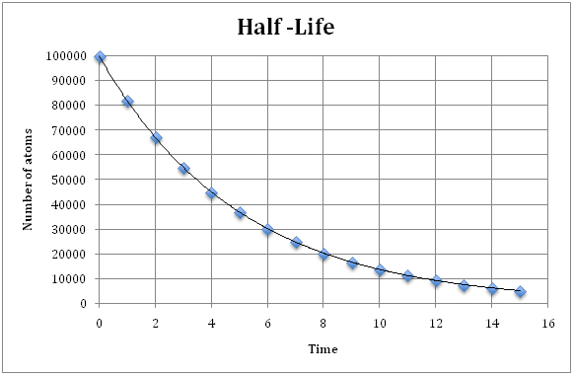
Measurement of half-life
Record activity
plot graph
read off
repeat and average

Slide 49
Implications of half-life
Isotopes with long half-lives will have a steady rate of activity over longer time periods and will last a long time therefore suited to long term uses requiring steady activity
e.g. monitoring foil thickness, smoke detectors
Isotopes with short half-lives will have a very large activity to start with but will rapidly decay away to nothing therefore suited to short large bursts of radiation where you don’t want to leave anything behind
e.g. most nuclear medicine uses, one-off uses

Slide 50
Danger of radiation
Spread of a radioactive source is more dangerous than spread of radiation itself
No type of radiation can spread over particularly large distances
Sources can be carried by water or wind over enormous distance
Sources will continue to emit over a long time period

Slide 51
Alpha (α)
Does the most damage by:
Blundering through tissue wreaking havoc on a molecular scale.
Knocks electrons out of orbit, causing changes to structure of molecule or forming radicals that cause damage.
Positive charge allows easy access to electrons.
Size helps in destruction
Speed limits distance it can travel ( within cell or through a few)

Slide 52
Beta (β)
Can knock out an electron from orbit as is moving rapidly, even though negatively charged. Ionizes molecules.
Energy delivered heats up cell.
Quite penetrating

Slide 53
Gamma (γ)
Form of em radiation with highest energy.
Can cause ionisation to a lesser degree.
Gives electrons so much energy they are knocked free from an atom.
Heats up cells.
Very penetrating.

Slide 54
Neutron
No charge so very penetrating
Can be absorbed by a nucleus potentially destabilising it, causing it to become radioactive itself

Slide 55
Energy of radiation
Use to approximate danger of exposure
Measured in electron volts (eV)
The energy an electron would gain if accelerated by a emf of 1V
1eV = 1.6x10⁻¹⁹ J
Alpha= 5-10 MeV
Beta = 1.4 MeV
Gamma= 0.1 MeV
8x10⁻¹³ - 1.6x10⁻¹² J
2.24x10⁻¹³ J
1.6x10⁻¹⁴ J

Slide 56

Absorbed Dose
A 80kg man receiving 200J of energy across his body is at much less risk than a 15kg dog receiving 200J of energy across its body
$$Absorbed dose (Gy) = \frac{energy absorbed (J)}{mass of tissue (kg)}$$
Absorbed dose accounts for mass, measured in Grays (Gy), equivalent to J kg⁻¹
Need to consider whether the whole body receives the dose or just one organ

Slide 57
Absorbed dose - example
What is the absorbed dose for a man (75kg) and for a boy (25kg) if both received 150J of radiation energy?
2Gy for man, 6Gy for boy
Man will suffer severe radiation sickness
Boy will die within 2 weeks

Slide 58

Dose Equivalent
A man receiving 2 Gy of Alpha radiation is not the same as a man receiving 2 Gy of Gamma rays
$Dose Equivalent (Sv)=Absorbed Dose \left(Gy\right)×Quality Factor$
The damage a type of radiation can cause is not simply proportional to its energy
Dose Equivalent (Sieverts) accounts for the type of radiation as well, most meaningful way to measure radiation doses
Radiation | Quality Factor
Alpha | 20
Beta | 1
Gamma | 1
Slow Neutron | 3
Fast Neutron | 10

Slide 59
Dose equivalent - example
A 10g tumour absorbs 0.002J of energy from an applied radiation source
What is the absorbed dose?
Calculate the dose equivalent for an alpha dose:
Calculate the dose equivalent for a gamma dose:
Which source is the most damaging to the tumour?
0.2 Gy
4 Sv
0.2 Sv
The alpha radiation

Slide 60
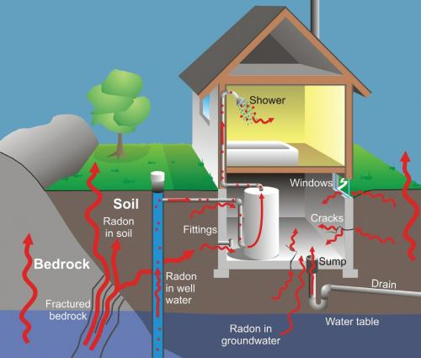
Terrestrial Radiation
Radioactive materials around us; air, food, ground
Radon Gas
Occurs naturally in atmosphere
Decay of U-238
Radon not dangerous but daughter products are as they are solid.
Breathe in Radon, daughter products collect inside you

Slide 61
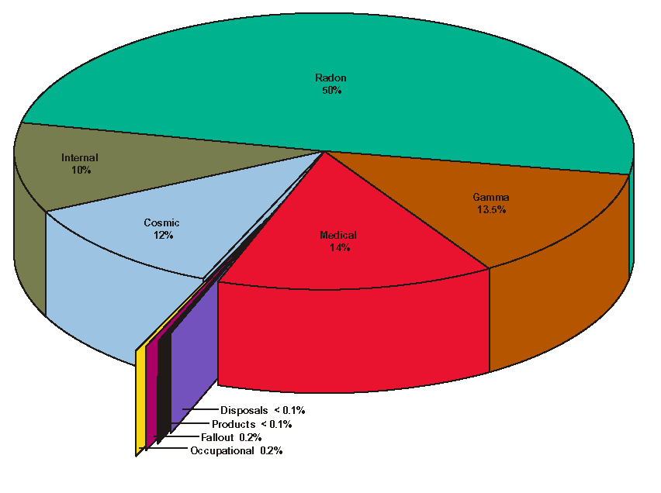
Typical sources of ionizing radiation exposure in the US

Slide 62
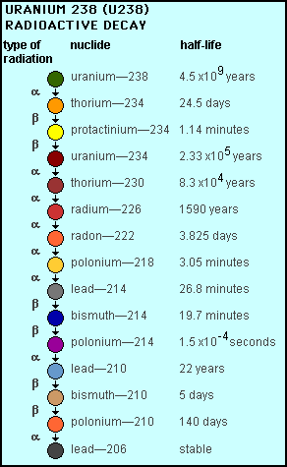
Origin of radon

Slide 63
Effects of radiation
Somatic effects
Damage to cells that can be passed on to subsequent cells through division
Very wide range of effects (burns, cancer, anemia, hair loss, radiation sickness)
Some symptoms present immediately, some are delayed
Genetic effects
Damage to DNA in sperm or egg cells
Results in birth defects passed on to the next generation

Slide 64
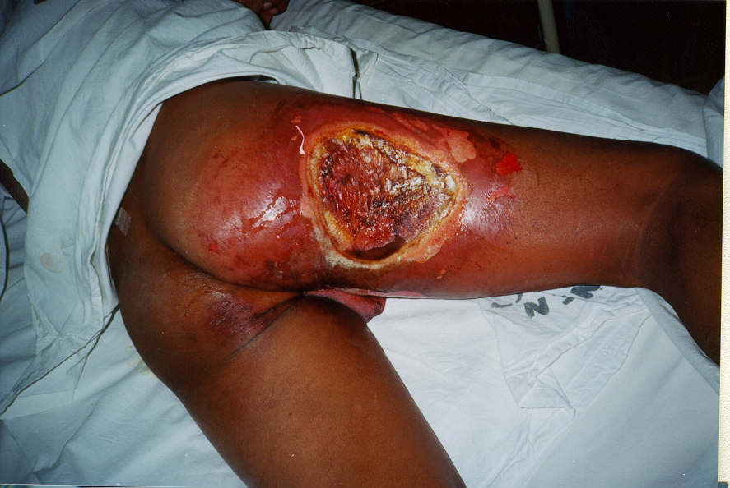
Deterministic vs Stochastic effects
Small doses have a small random chance to cause things such as cancer (stochastic effect)
Doses over a certain threshold are essentially guaranteed to have certain effects (deterministic effect) the severity of these effects increase with size of dose over the threshold
Varies by tissue type
skin erythema: 2-5 Gy
irreversible skin damage: 20-40 Gy
hair loss: 2-5 Gy
sterility: 2-3 Gy
cataracts: 5 Gy
lethality (whole body): 3-5 Gy
fetal abnormality: 0.1-0.5 Gy

Slide 65
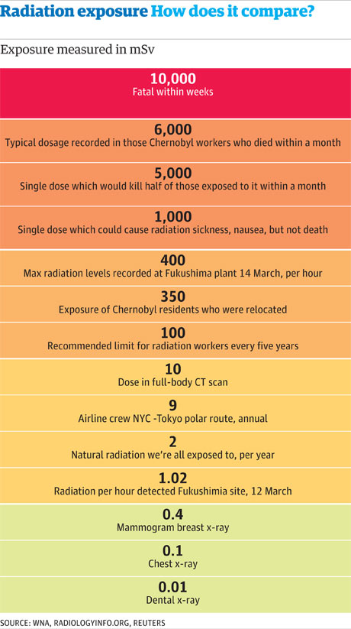
Lethal Dose
Hard to define simply due to variation between individuals (and a lack of experimental data)
1 Sv = severe radiation sickness
Lethal ld: LD₅₀ = a dose that kills 50% of exposed subjects
LD₅₀/25 = a dose that kills 50% of exposed subjects in 25 days

Slide 66
Binding energy
The total mass of a stable nucleus is always less than the sum of the masses of its constituent protons and neutrons.
⁴₂He = 4.002602u
However, mass of 2 protons (2.017330u) + mass of 2 neutrons (2.0156504u) = 4.032980u.
Mass difference = 0.030378 u.
Where is this missing mass?
It has left in the form of energy (radiation and E_{K}).
This missing energy is the binding energy

Slide 67
Binding energy continued
The total binding energy of the nucleus is related to the difference in the mass of the atom and its constituent nucleons (ie protons and neutrons).
This is the energy lost by the nucleons when they come together to form a nucleus and is equal to the amount of energy that must be put into a nucleus to break it apart into its constituent nucleons.
Binding energy = change in mass × mass energy equivalence
Binding energy He = 0.030378u × 931 = 28.3 MeV of energy.

Slide 68




Mass energy equivalence e=mc²
x c² ([3x10⁸]²)
Mass (kg)
Energy (J)
$÷$ c² ([3x10⁸]²)
x 1.6x10⁻¹⁹
x 1x10⁶
$÷$ 1.6x10⁻¹⁹
$÷$ 1x10⁶
x 1.66x10⁻²⁷
$÷$ 1.66x10⁻²⁷
x 931
Mass (u)
Energy (MeV)
$÷$ 931
All numbers on datasheet

Slide 69
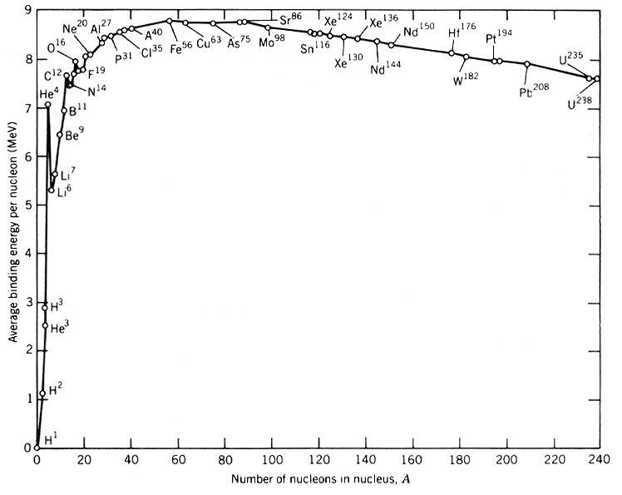
A greater binding energy per nucleon = a greater stability of the nucleus
Average binding energy per nucleon = total binding energy / # nucleons
E.g. He = 28.3/4 = 7.07 MeV nucleon⁻¹

Slide 70
Iron-56 example
Fe-56 is the maximum binding energy per nucleon
Therefore most stable nucleus
Calculate the total binding energy for Fe-56 and its binding energy per nucleon. The mass of Fe-56 is 55.9349375 u.
Fe-56 has 26 protons (p) and 30 neutrons (n).
See data sheet for mass of protons and neutrons

Slide 71
Iron-56 worked answer
That is
mass p = 26 × 1.67 x10⁻²⁷kg = 4.342x10⁻²⁶kg
mass n = 30 × 1.67 x10⁻²⁷kg = 5.01x10⁻²⁶kg
total mass = 9.352x10⁻²⁶kg
9.352x10⁻²⁶kg ÷ 1.66x10⁻²⁷=56.3373494u
Δm = 56.3373494- 55.9349375 u
= 0.402411897 u
Binding energy = 0.402411897 × 931 = 374.6455 MeV
Average binding energy/nucleon
374.6455 ÷ 56 = 6.69 MeV
(NB: This uses data from data sheet)

Slide 72
Worked example using u
mass p = 26 × 1.007276 u = 26.189176 u
mass n = 30 × 1.008665u = 30.25995 u
total mass = 56.449126 u
Δm = 56.449126 u - 55.9349375 u
=0.5141885 u
Binding energy = 0.5141885 u × 931 = 478.7094935 MeV
Average binding energy nucleon-1
478.7094935 ÷ 56 = 8.54838 MeV
(NB: Uses data from question)

Slide 73
Fusion and fission
Fusion and fission can both release energy despite being opposite reactions
Energy is released from a nuclear reaction if the average binding energy per nucleon increases in the reaction
Any reaction moving towards Fe-56 will therefore release energy

Slide 74
Fission
Nuclear fission occurs when an atomic nucleus splits into 2 or more pieces. This is often triggered by the absorption of a neutron
Fissile material = nuclides that are capable of undergoing nuclear fission after absorbing a neutron.
Eg : U-235 and Pu-239 = readily fissile
U-238 and Th-232 = slightly fissile with a high energy neutron.

Slide 75
Uranium
Natural uranium is 99.284% U-238 isotope, with U-235 only constituting about 0.72 % of its weight.
U-235 is the only isotope existing in nature (in any appreciable amount) that is fissionable by thermal (slow) neutrons.
Enriched uranium is a sample of uranium in which the percent composition of uranium-235 has been increased through the process of isotope separation.
Enriched uranium is a critical component for both civil nuclear power generation and military nuclear weapons. The U -238 remaining after enrichment is known as depleted uranium (DU), and is considerably less radioactive than even natural uranium, though still extremely dense. It is useful for armour, penetrating weapons, and other applications requiring very dense metals.

Slide 76
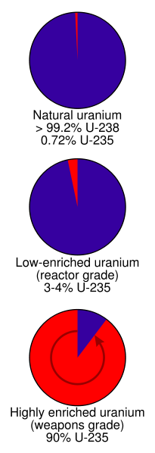
Grades of enrichment
Slightly enriched uranium (SEU) has a U-235 concentration of 0.9% to 2%. Used in heavy water reactors like the CANDU.
Low-enriched uranium (LEU) has a lower than 20% concentration of U-235. Use in commercial light water reactors (LWR) - 3 to 5 % U-235. Research reactors -12% to 19.75% U-235,
Highly enriched uranium (HEU) has a greater than 20% concentration of U-235 or U-233.
The fissile uranium in nuclear weapons usually contains 85% or more of U-235 - weapon(s)-grade

Slide 77
Enrichment process
Enrichment use the slight differences in atomic weights of the various isotopes.
The gas centrifuge process uses a large number of rotating cylinders in series and parallel formations. This rotation creates a strong centrifugal force so that the heavier gas molecules containing U-238 move toward the outside of the cylinder and the lighter gas molecules rich in U-235 collect closer to the centre.

Slide 78
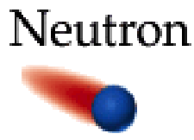
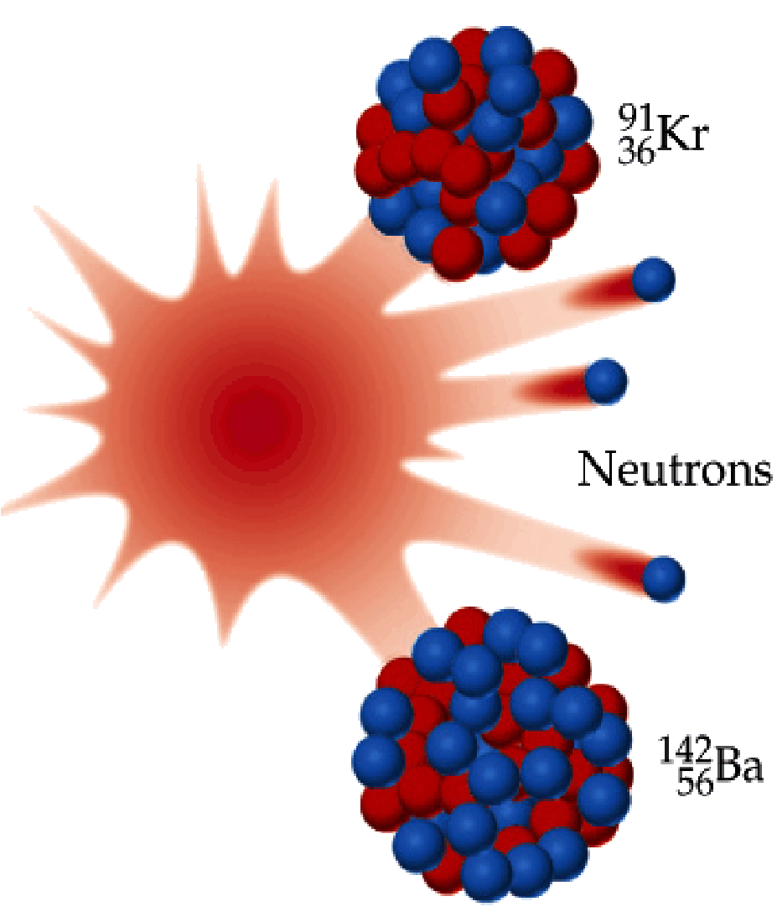
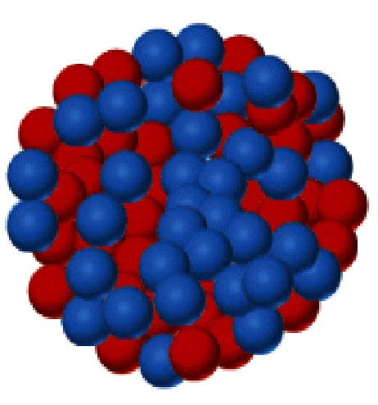
Fission of U-235
One of several possible reactions
On average 2.5 neutrons are released

Slide 79
U-235 fission
¹₀n +²³⁵₉₂U → ²³⁶₉₂U → ⁹¹₃₆ Kr + ¹⁴²₅₆Ba +3¹₀n
U-235 requires a slow neutron but reaction releases fast neutrons.
Amount of energy released is 200 MeV in the form of kinetic energy , gamma rays and heat.
This energy originates from mass being converted into energy : E = mc²

Slide 80
Chain reaction
Fission is triggered by a neutron and releases more neutrons, can become self-sustaining
Each fission must produce at least one neutron that will trigger a further fission
Any given neutron could be:
Lost
Abosrbed without reaction
Absorbed causing fission

Slide 81
Critical Mass
Critical mass is the minimum mass required for the reaction to become self-sustaining, is shape dependent (amongst other factors)
Sphere gives smallest critical mass, smallest SA:V, fewest number of neutrons lost
Sub-critical mass: cannot sustain chain reaction
Critical mass: self-sustaining chain reaction occurring at constant rate (reactors)
Super-critical mass: runaway chain reaction occurs at increasing rate (weapons)

Slide 82
Fission reaction equation examples
¹₀n + ²³⁹₉₄Pu → ¹⁴⁵₅₆Ba + ⁹³₃₈Sr + ___¹₀n
¹₀n + ²³⁹₉₄Pu → _______ + ⁹²₃₆Kr + 2 ¹₀n
2
¹⁴⁶₅₈Ce

Slide 83
Fission reaction energy example
Calculate for following reaction:
¹₀n +²³⁵₉₂U → ²³⁶₉₂U → ⁹²₃₆ Kr + ¹⁴¹₅₆Ba +3¹₀n
Mass defect
Masses: U-235 = 235.04393u, Ba-141 = 140.91440, Kr-92 = 91.92630u n = 1.00866u.
Energy released per U atom in J and MeV
Energy released by 1 kg of U-235 all fission

Slide 84
Fission reaction energy working
Mass reactants = 235.04393 + 1.00866 = 236.05259u
Mass products = 91.92630 + 140.91440 + 3x1.00866= 235.86668u
Mass defect = 236.05259 - 235.86668 = 0.18591u
Energy released per U in MeV = 0.18591 x 931 = 173.08221 MeV
Energy released per U in J = 173.08221x10⁶ x 1.6x10⁻¹⁹ = 2.76931536x10⁻¹¹
Mass of U atom in kg = 235.04393 x 1.66x10⁻²⁷ = 3.901729238x10⁻²⁵ kg
No. of U atoms in 1 kg of U = 1 / 3.901729238x10⁻²⁵ = 2.562966159x10²⁴ atoms
Energy released per kg of U-235 = 2.562966159x10²⁴ x 2.76931536x10⁻¹¹ ⁼ 7.10x10¹³ J

Slide 85
Thermal nuclear reactors
Attempt to maintain a steady sustained fission chain reaction in the fuel
Energy released heats water, creating steam to turn a turbine creating electricity

Slide 86
Thermal nuclear reactor – 5 Problems
Fission produces fast neutrons but is triggered by slow neutrons
Solution: Moderator, a material that slows down the neutrons
Good moderators slow neutrons without absorbing them (water, graphite, heavy water, CO₂
Release of 2-3 neutrons per fission will result in an uncontrolled runaway chain reaction, need to control number of neutrons in system
Solution: Control rods, material that absorbs neutrons (cadmium, boron steel) that can be inserted or retracted as needed to control number of neutrons present

Slide 87
Thermal nuclear reactor – 5 Problems
Natural U is only 0.7% U-235, need more to sustain chain reaction
Solution: enrich fuel to 2.3% U-235
Fuel rods are thin Al tubes containing spherical pellets of enriched U, 1000 in a reactor, last 4 years
Heat produced has to be collected and diverted to generate electricity
Solution: pipes containing coolant (liquid sodium, water, CO₂ or heavy water)

Slide 88
Thermal nuclear reactor – 5 Problems
Generates dangerous neutron and gamma radiation, have to protect workers
Solution: 2m thick casing around core made of layers of concrete, graphite, steel and lead to reflect and absorb radiation, workers are monitored

Slide 89
Fusion
Nuclear fusion occurs when two small atomic nuclei fuse to form a new heavier nucleus
Occurs in stars, source of their heat
Forms heavier elements from light elements

Slide 90
Fusion energy example
deuterium + tritium → helium-4 + neutron (masses in STAWA pg 80)
Mass of reactants = 2.01355 + 3.01605 = 5.0296u
Mass of products = 4.00260 + 1.00866 = 5.01126u
Mass defect = 5.0296 - 5.01126 = 0.01834u
Energy released = 0.01834 x 931 = 17.07454 MeV

